Slide 1
Business Intelligence G. Mudare

Slide 2
Mining Frequent Patterns,Associations

Slide 3
Model
A model is a high-level, global description of a data set and takes a large sample perspective. It may be :
1. descriptive—summarizing the data in a convenient and concise way
—or
inferential (predictive) - allowing one to make some statement about the population from which the data were drawn or about likely future data values.
In contrast, a pattern is a local feature of the data, perhaps holding for only a few records or a few variables (or both).

Slide 4
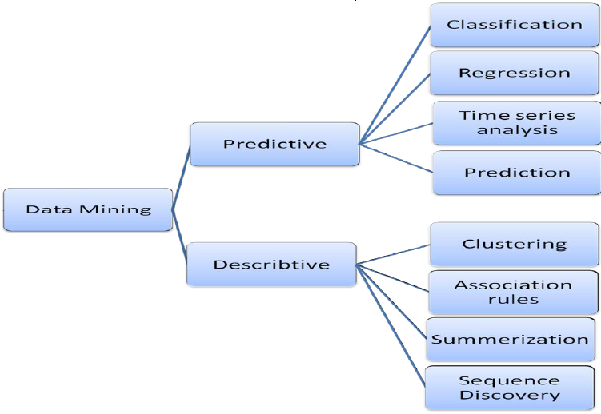
Data Mining Models

Slide 5
Models
ASSOCIATION
ATTRIBUTE_IMPORTANCE
CLASSIFICATION
CLUSTERING
FEATURE_EXTRACTION
REGRESSION

Slide 6
ASSOCIATION and Algorithms
Association is a descriptive mining function.
An association model identifies relationships and the probability of their occurrence within a data set.
Association models use the Apriori algorithm.
The Association model is often associated with "market basket analysis", which is used to discover relationships or correlations in a set of items.
It is widely used in data analysis for direct marketing, catalog design, and other business decision-making processes
for example, "70% of the people who buy spaghetti, wine, and sauce also buy garlic bread."

Slide 7
Association models
Association models capture the co-occurrence of items or events in large volumes of customer transaction data.
Because of progress in bar-code technology, it is now possible for retail organizations to collect and store massive amounts of sales data.

Slide 8
Frequent patterns
Frequent patterns are patterns that appear in a data set frequently.
For example, a set of items, such as milk and bread, that appear frequently together in a transaction data set is a frequent itemset.
A subsequence, such as buying first a PC, then a digital camera, and then a memory card, if it occurs frequently in a shopping history database, is a (frequent) sequential pattern.
Finding such frequent patterns plays an essential role in mining associations, correlations, and many other interesting relationships among data.

Slide 9
Frequent pattern Mining
Market basket analysis is the earliest form of frequent pattern mining for association rules.
Frequent itemset mining leads to the discovery of associations and correlations among items in large transactional or relational data sets.
Market basket Analysis analyzes customer buying habits by finding associations between the different items that customers place in their “shopping baskets”

Slide 10
Association Rules
If we think of the universe as the set of items available at the store, then each item has a Boolean variable representing the presence or absence of that item in a given basket.
Each basket can then be represented by a Boolean vector of values assigned to these variables.
The Boolean vectors can be analysed for buying patterns that reflect items that are frequently associated or purchased together
These patterns can be represented in the form of association rules.

Slide 11
Association Rules
Eg customers who purchase computers also tend to buy antivirus software at the same time is represented as:
Computer’’→ antivirus software [support = 2%; confidence = 60%] Or
buys(X, “computer”)→buys(X, “antivirus software”)
The support and confidence are two measures of rule interestingness.
They respectively reflect the usefulness and certainty of discovered rules.
A support of 2% for Association Rule means that 2% of all the transactions under analysis show that computer and antivirus software are purchased together.
A confidence of 60% means that 60% of the customers who purchased a computer also bought the software

Slide 12
Association Rules
Association rules are considered interesting if they satisfy both a minimum support threshold and a minimum confidence threshold.
Such thresholds can be set by users or domain experts.
Additional analysis can be performed to uncover interesting statistical correlations between associated items.
Thus the problem of mining association rules can be reduced to that of mining frequent item sets.

Slide 13
Association rule
In general, association rule mining can be viewed as a two-step process:
Find all frequent itemsets: By definition, each of these itemsets will occur at least as frequently as a predetermined minimum support count, min sup.
Generate strong association rules from the frequent itemsets: By definition, these rules must satisfy minimum support and minimum confidence.
Additional interestingness measures can be applied for the discovery of correlation relationships between associated items

Slide 14
Challenges
A major challenge in mining frequent itemsets from a large data set is the fact that such mining often generates a huge number of itemsets satisfying the minimum support (min sup) threshold, especially when min sup is set low.
If a rule references two or more dimensions, such as the dimensions age, income, and buys, then it is a multidimensional association rule.

